Slide 1
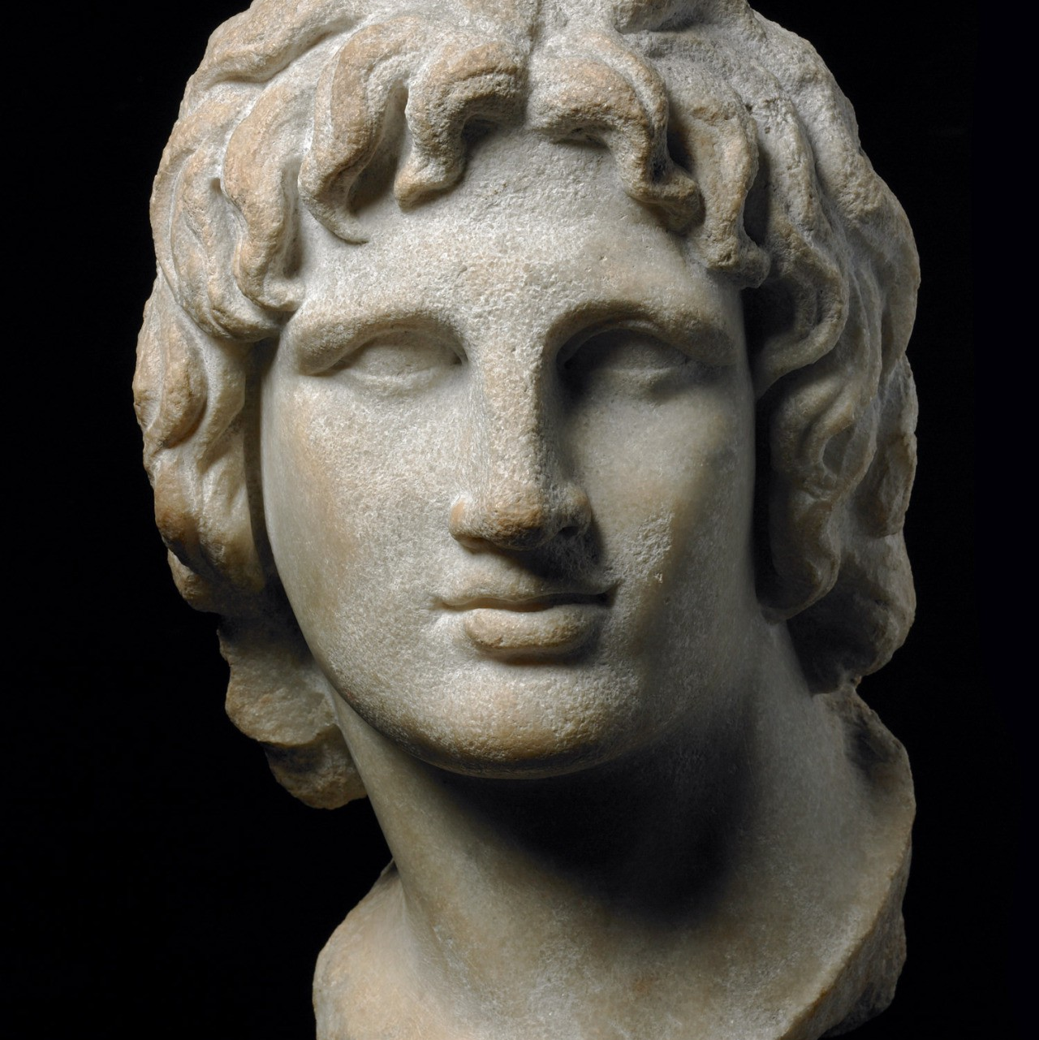
Methods
Year 11 Ancient History
Week 2 – Lesson 4

Slide 2
Activity 1: Battle Tactics information sheet.
Read through the information sheet as a class.
Highlight key words/concepts.
Write them n the left hand column.

Slide 3
Activity 2: Questions
Define the following terms: phalanx, hypaspists, dekas,
Identify and describe the disadvantages of the Phalanx
Why was the Cavalry the single greatest weapon in Alexander’s disposal?
Write 2 - 3 sentences describing Alexanders ‘Battle Strategy’.

Slide 4
Activity 3: Video
Get into groups of 3 – 4 Watch the following video
https://www.youtube.com/watch?v=C8DzzseqBMw
After the video, create a GRAFFITI of key terms/ideas shown in the video.
These will be displayed.

Slide 5
Summary
Do you believe Alexander deserves his title of ‘Great’? Why/why not?

